Slide 1
YouTube Sentiment Analysis
Contributed by :-
Rushang Shah
Shyamal shah
Rushi shah
Meet Doshi

Slide 2
What is Sentiment Analysis?
• Sentiment Analysis is the process of determining whether a piece of content is positive, negative or neutral.
• Also referred to as opinion mining, it makes our goal to determine whether the data is positive, negative or neutral.

Slide 3
Why YouTube Data for Sentiment Analysis?
Popular site.
More than 23 Million YouTube Channels.
300 hours of video are uploaded to YouTube every minute.
Almost 5 billion videos are watched on YouTube every single day.
YouTube gets over 30 million visitors per day.

Slide 4

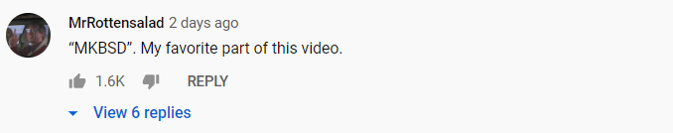

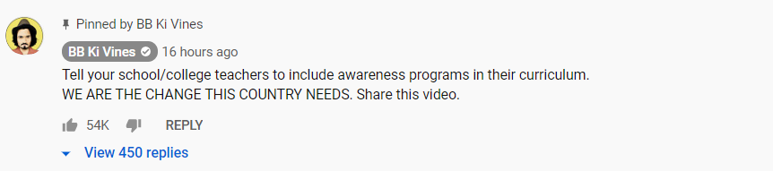
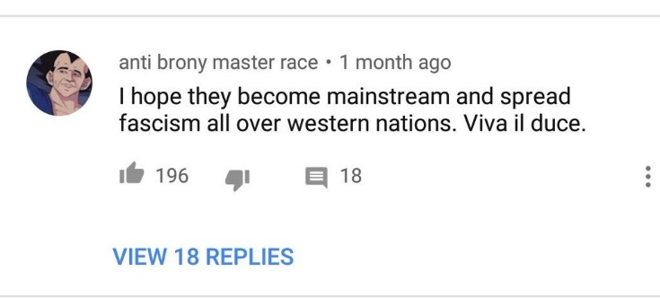
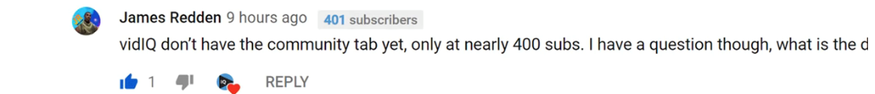

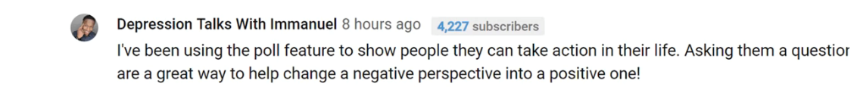
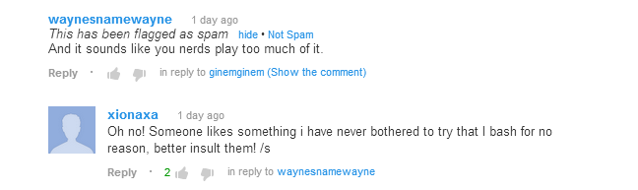

Slide 5
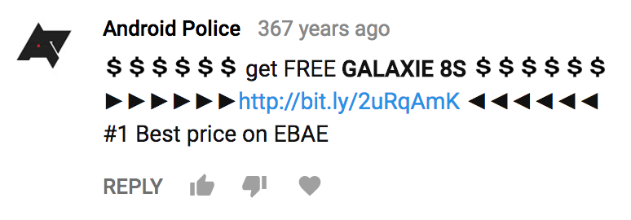
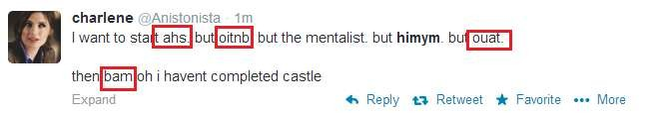
Challenges
Comments are highly unstructured and also non-grammatical
Out of Vocabulary Words

Slide 6
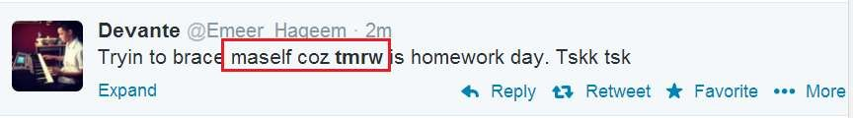
Lexical Variation
Extensive usage of acronyms like asap, lol, afaik.

Slide 7
Process Flow
YouTube Dataset
Pre-processing
Classifier tranning
Feature Extraction (Word +Senti Feature)
Classification

Slide 8
YouTube Data Set And Pre-Processing
We use YouTube data v3 search data API to fetch 50 most recently uploaded video’s meta data for the channel
Then we use you tube's comment thread API Call to fetch comments via the video ID for every video.
Then we tokenize every comment using NLTK Word Tokenizer.

Slide 9
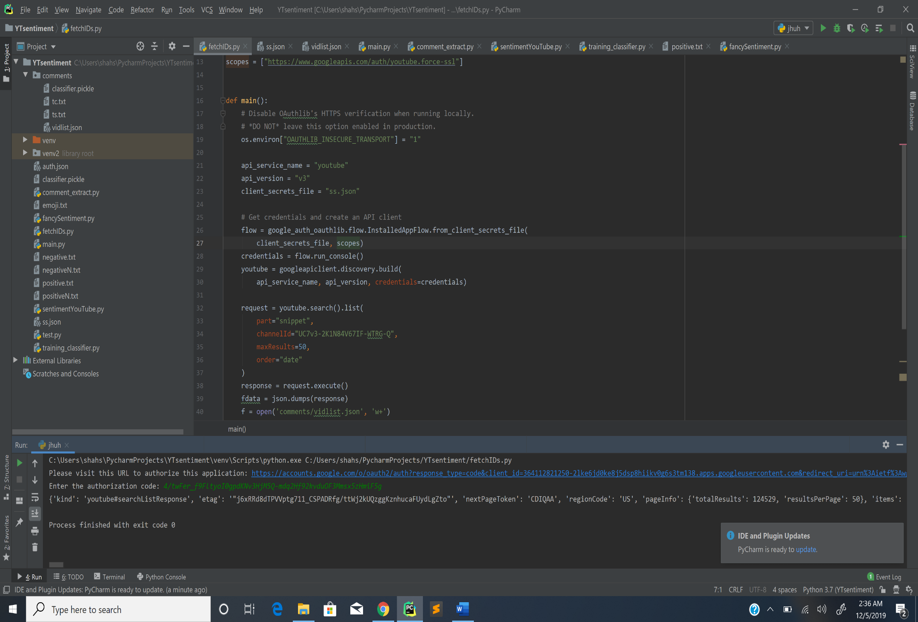

Slide 10
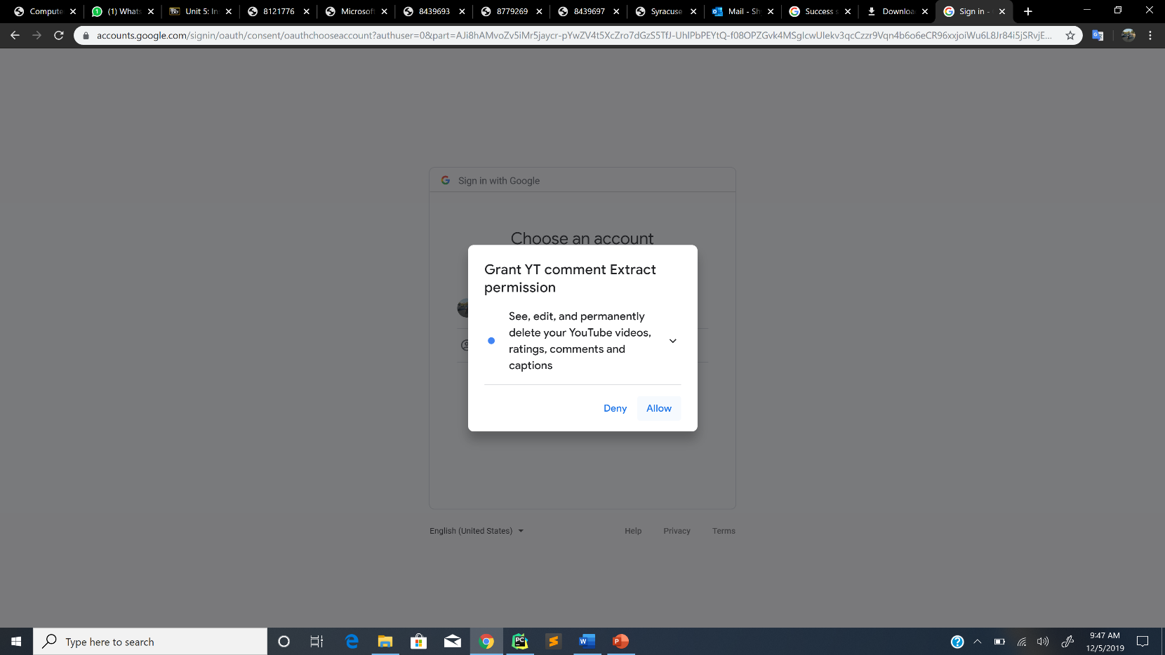

Slide 11
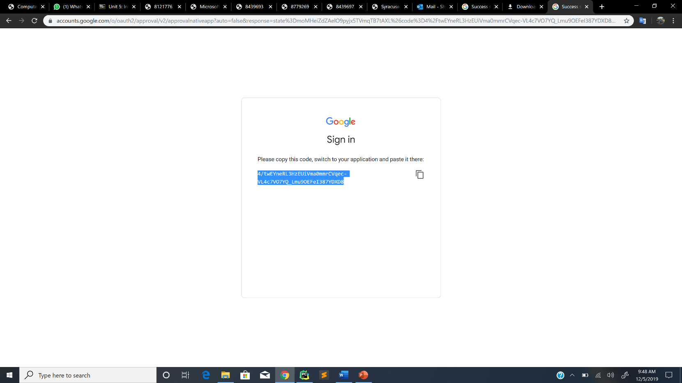

Slide 12
Feature Extraction And Sentiment Analysis
Then we create NLTKs BigramAssocMeasures and BigramCollocationFinder to create Bigrams.
Then we check if any classifier is already trained. If there are no pre trained classifiers, then we create a new classifier via out training data set.
Then each comment of a particular video is classified using the naïve bayes classifier as positive and negative and then the average sentiment is calculated.

Slide 13
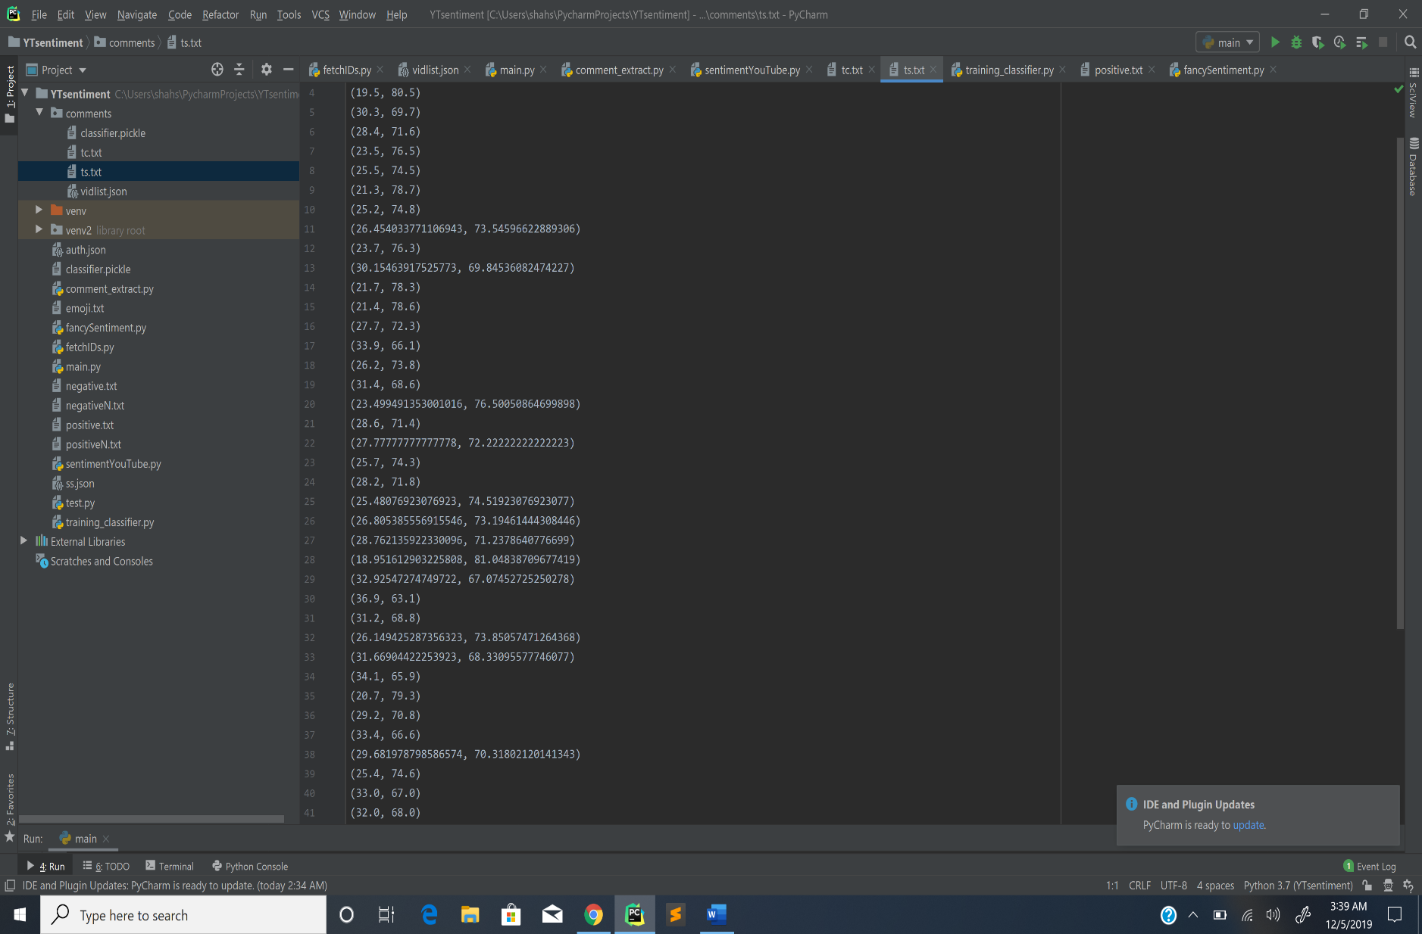

Slide 14
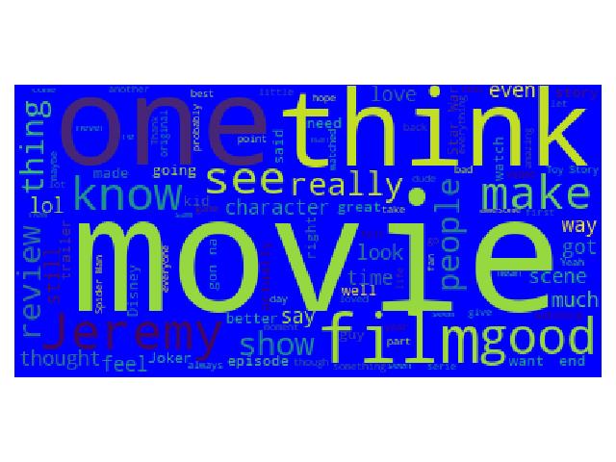

Slide 15
Question?

Slide 16
Thank you!

